Slide 1
RDS Blocking
Introduction:
When two queries are executed at a time on a table, one of the query gets blocked

Slide 2
Our acknowledgement
If got any RDS related blocking alerts just we acknowledged and inform to L2 people.
There will take care of that.
Sometimes blockings got cleared automatically.

Slide 3
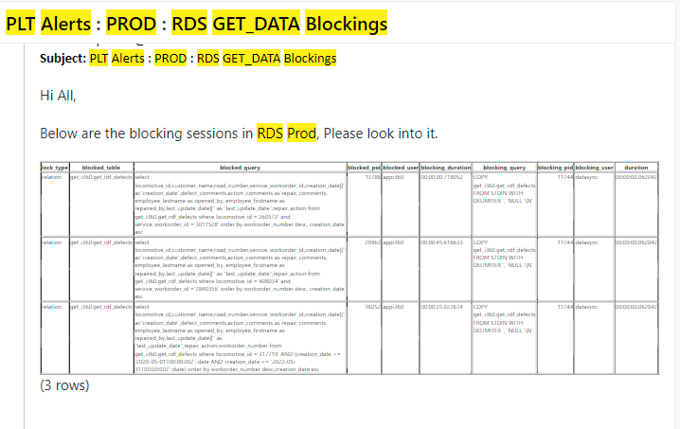
Diagrammatical Representation:

